Slide 1
Dynamics 365 Finance and Operations
Microsoft Dynamics 365 finance and operations is the best solution to maximize financial visibility and profitability.
D365 Finance and Operations combines worldwide financials and operations to enable a business to make prompt, well-informed choices.
Dynamics 365 finance and operations supports a company’s swift response to shifting consumer needs and quick expansion.

Slide 2
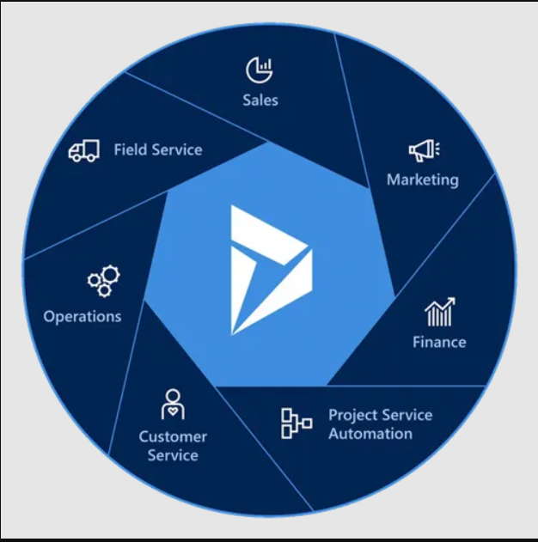
Brief overview of Dynamics 365 Finance and Operations
Microsoft Dynamics 365 Finance and Operations is a cloud-based ERP system designed to meet the expectations of large or diversified companies and help them drive business agility and growth with embedded analytics, financial reporting, and AI-driven insights.

Slide 3
Features of F&O
Financial Management: General Ledger, Accounts Receivable, Accounts Payable
Supply Chain Management: Procurement, Inventory Management, Production
Project Management: Project Planning, Cost Management, Billing
Human Resources: Employee Management, Payroll, Talent Management

Slide 4
Benefits
Integrated Solutions: Unified financial and operational data
Scalability: Adaptable to growing business needs
Automation: Streamline processes and reduce manual tasks
Data Insights: Real-time analytics and reporting
Compliance: Support for industry standards and regulations

Slide 5
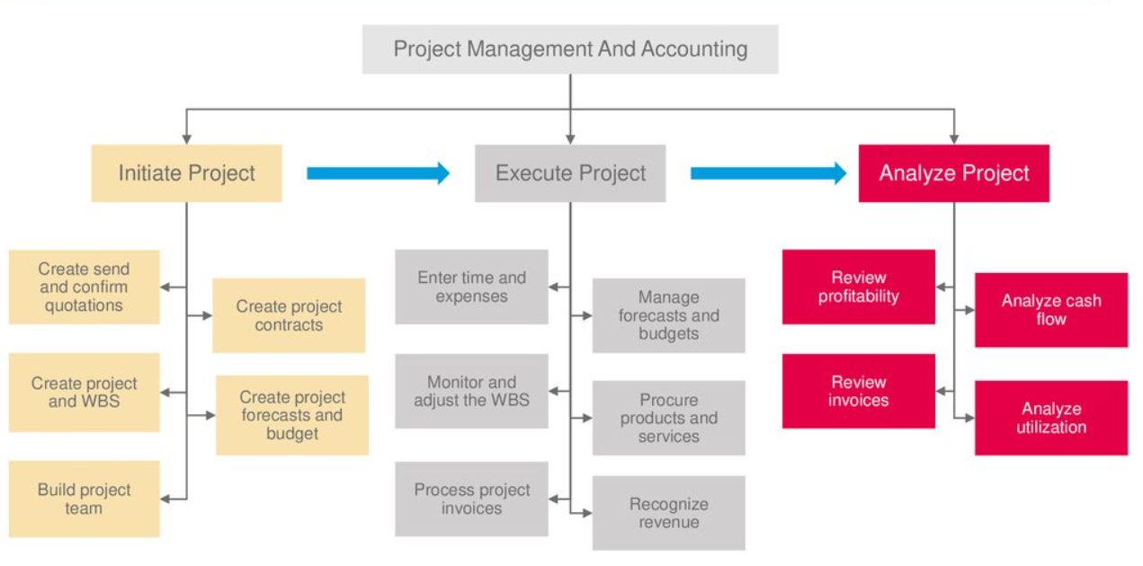
Project management and accounting

Slide 6
Project management and accounting
Project Planning and Scheduling
Project Contracts: Manage project contracts, including billing terms, payment schedules, and cost structures. Create contract lines for different types of billing (fixed price, time and materials, etc.).
Task Management: Create and assign tasks, set deadlines, and track progress. Define milestones to track key project achievements.
Time and Expense Tracking:
Time Entries: Record time spent on project tasks by team members. Capture hours worked for accurate billing and project tracking.

Slide 7
Project management and accounting
Expense Management: Track project-related expenses, including travel, materials, and other costs.
Project Accounting
Invoicing:
Invoice Generation: Create and manage invoices based on project milestones, time entries, or expenses. Supports various billing methods.
Revenue Recognition:
Recognition Methods: Manage and recognize project revenue based on accounting rules and billing terms.
Financial Reporting:
Reports: Generate financial reports to monitor project performance, including profitability, cost analysis, and revenue recognition.

Slide 8
Accounts Payable
Vendor Management:
Maintain detailed records for each vendor, including contact information, payment terms, and banking details.
Set up different types of vendors, such as standard, fringe, or project-based vendors.
Invoice Management:
Enter and process vendor invoices, including manual entry and integration with purchase orders.
Handle invoice matching and validation against purchase orders and receipts.
Payment Processing:
Schedule and process payments to vendors, either through electronic payments or traditional methods.

Slide 9
Manage payment proposals, generate payment batches, and handle payment approvals.
Reporting and Analytics:
Generate financial reports related to accounts payable, such as aging reports, payment history, and cash flow projections.
Use built-in analytics tools to gain insights into payment trends and vendor performance.
Integration with Other Modules:
Seamless integration with purchasing, inventory, and general ledger modules to ensure accurate and efficient financial management.

Slide 10
Accounts Receivable
Customer Management:
Customer Accounts: Create and manage customer profiles
Credit Management: Set and track credit limits and terms
Invoice Management:
Invoice Creation: Generate and send invoices
Invoice Posting: Record invoices and apply payments
Collections Management:
Collection Letters: Automated reminders and collection strategies
Aging Reports: Monitor outstanding balances and overdue accounts
Payments Processing:
Payment Methods: Process payments via various channels
Reconciliation: Match payments to invoices and reconcile discrepancies

Slide 11
Supply Chain Management

Slide 12
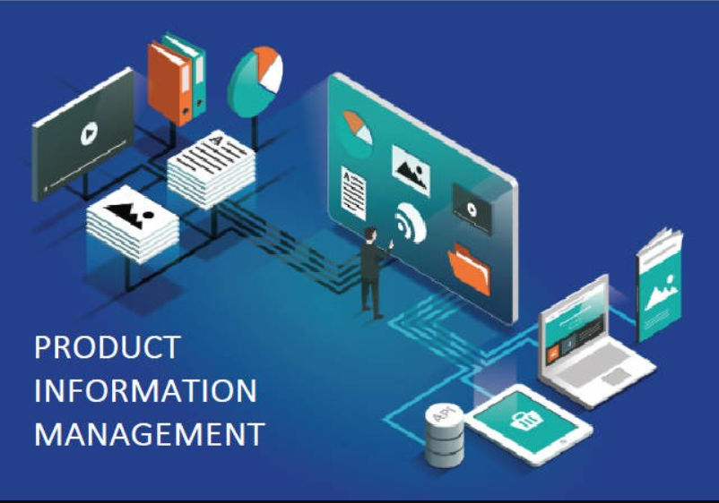
Product Information Management
Product Setup: Define and manage product attributes, variants, and pricing.
Product Hierarchies: Organize products into categories and subcategories to facilitate management and reporting.
Product Variants: Define product variants (e.g., sizes, colors) and associate them with attributes to manage different versions of a product.

Slide 13
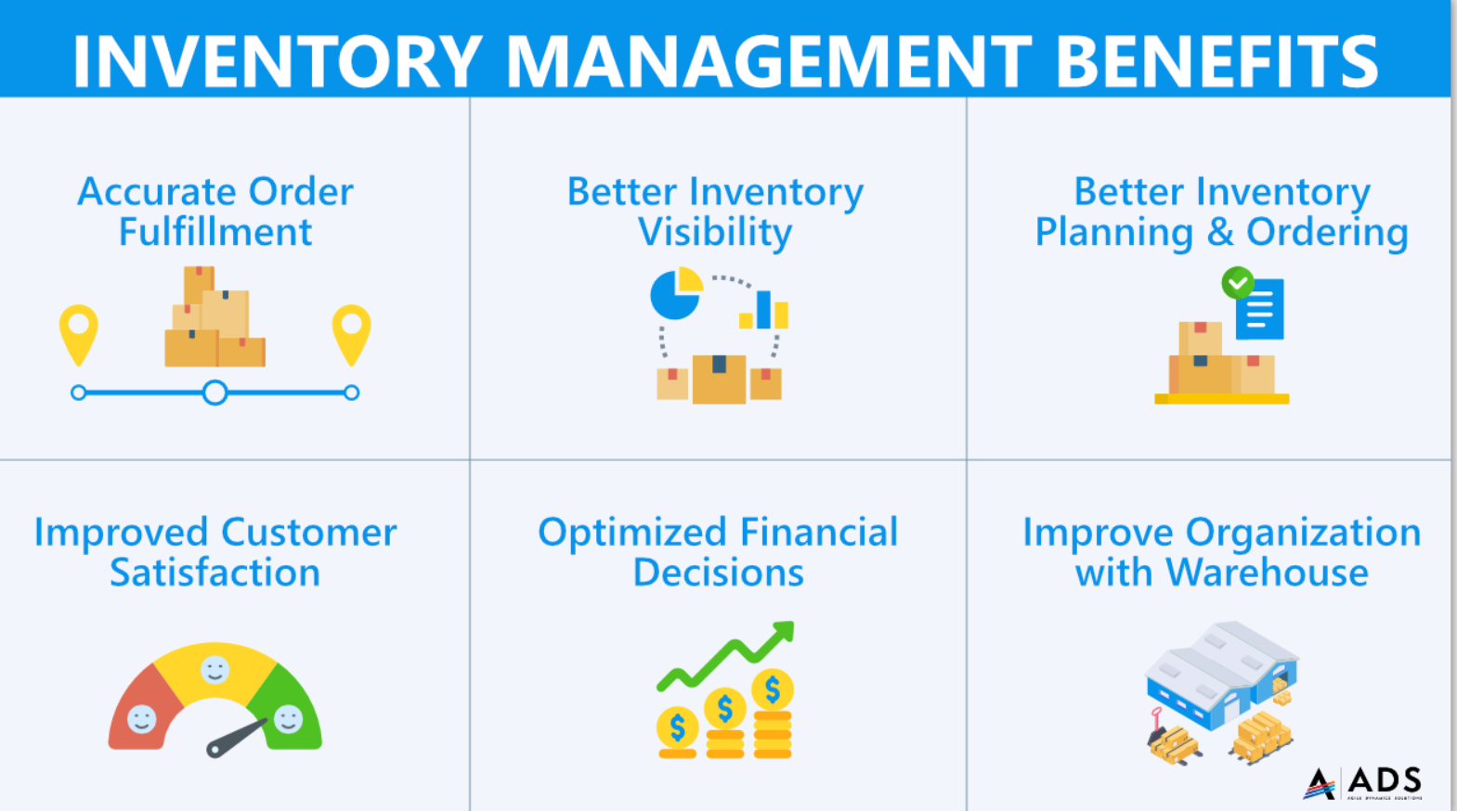
Inventory Management
Stock Management: Track inventory levels, manage warehouse locations, and handle inventory transactions.
Barcode and RFID Integration: Use barcodes and RFID for efficient inventory tracking and management.

Slide 14
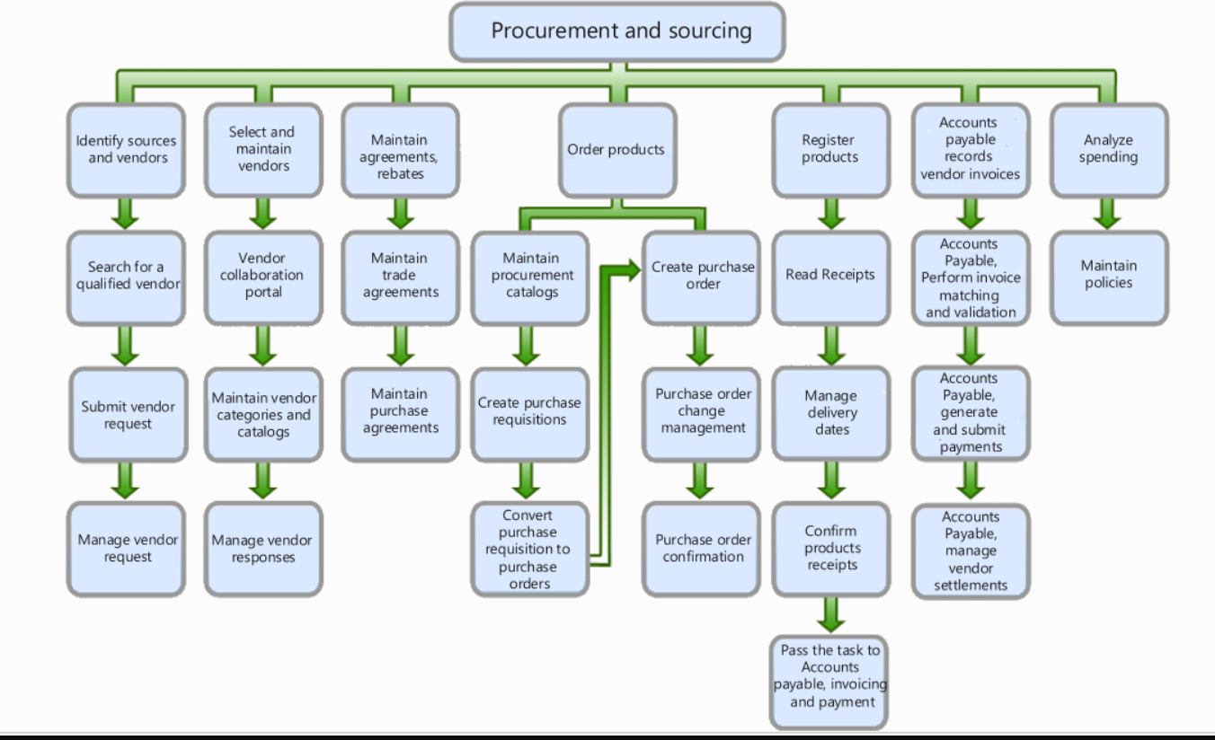
Procurement and Sourcing
Vendor Management
Purchase Orders
Purchase Agreements

Slide 15
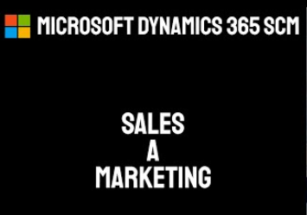
Sales and Marketing
Customer Management
Quotes: Create and manage sales quotes for customers, including pricing and terms.
Sales Orders: Convert quotes to sales orders, track order status, and manage fulfillment.
Order Processing: Handle order fulfillment, including picking, packing, and shipping.

Slide 16
Other Modules
Fixed Assets: Track and manage company assets, including depreciation and asset lifecycle.
Budgeting: The budgeting functionality is integrated across various modules, particularly within Finance and Project Management, to ensure effective financial planning and monitoring
Production Control: Oversee production orders, bill of materials (BOM), and routing.
Warehouse Management: Optimize warehouse operations, including inventory movement and work orders.
Transportation Management: Plan and manage transportation of goods, including shipment tracking and carrier management.

Slide 17
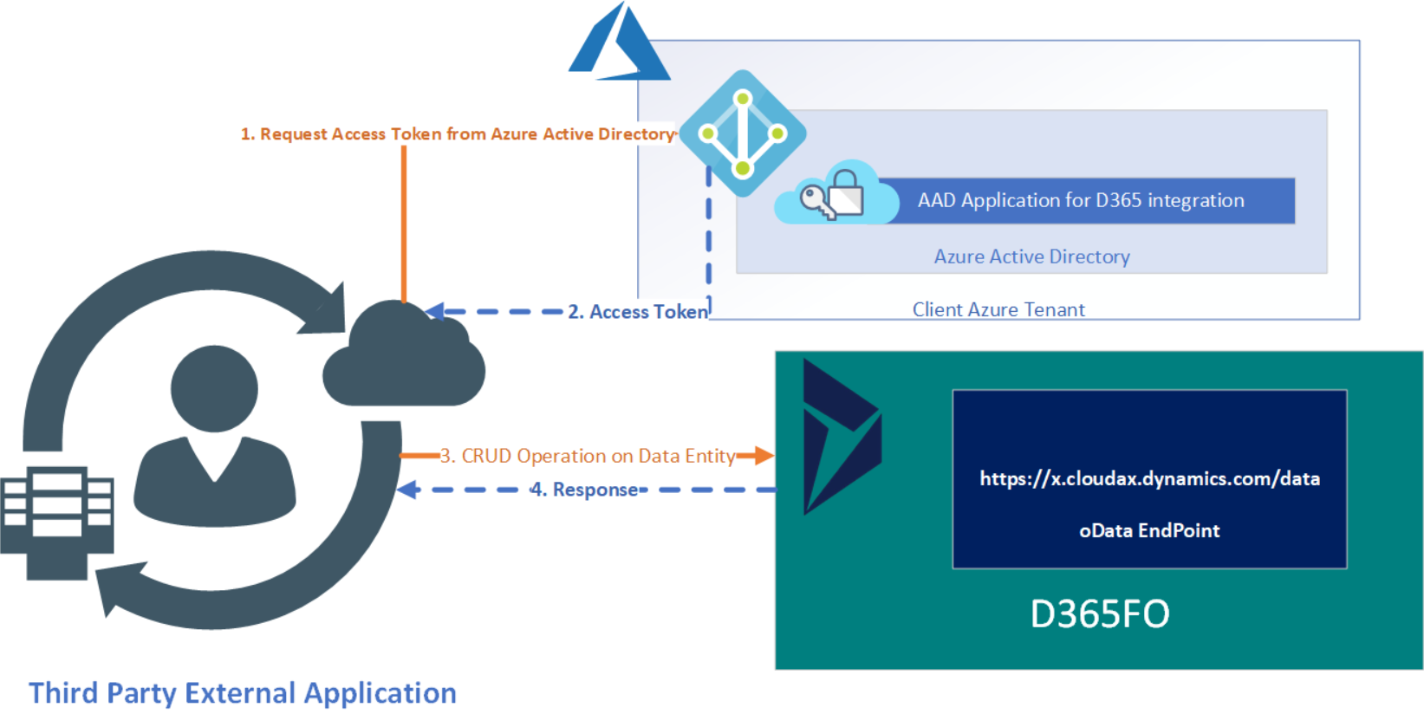
Architecture and Integration
Cloud-based Infrastructure: Benefits of cloud deployment
Data Security: Measures to protect sensitive information
Integration and Extensions
Integration Capabilities: APIs, third-party applications, and other Microsoft products
Power Apps: Create custom applications and workflows tailored to specific business needs.
Power Automate: Automate repetitive tasks and workflows across D365 and other applications.

Slide 18
Reporting
Standard and customize reports
Project Reporting.
Financial Reporting.
Procurement Reports etc.
Customize Reports as per the clients Requirement.
Power BI Integrated Reports.

Slide 19
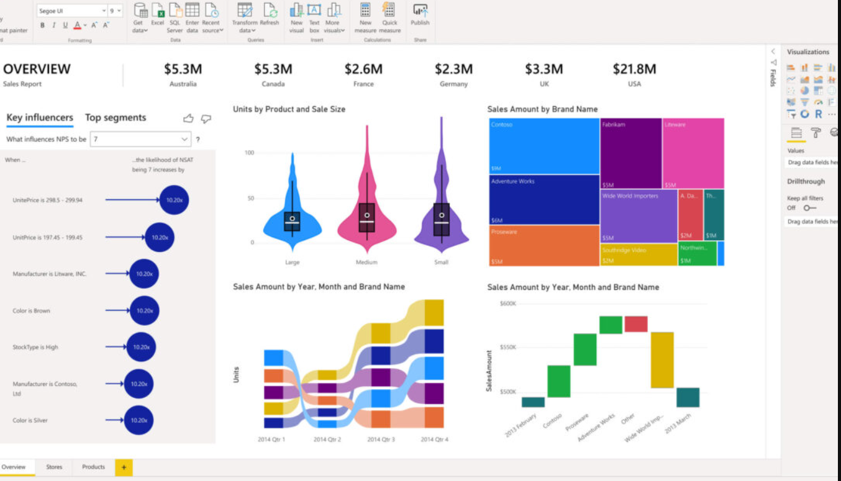
AI and Analytics
Power BI: Advanced business analytics and reporting tool integrated with D365 for creating interactive dashboards and reports.

Slide 20
Case Studies and Success Stories
Our Team have implemented ERP IN (X)number for companies
Project management and accounting.
Fixed assets.
Supply Chain Management.
Budgeting.
Expense management.
Human resources.

Slide 21
POWER BI

Slide 22
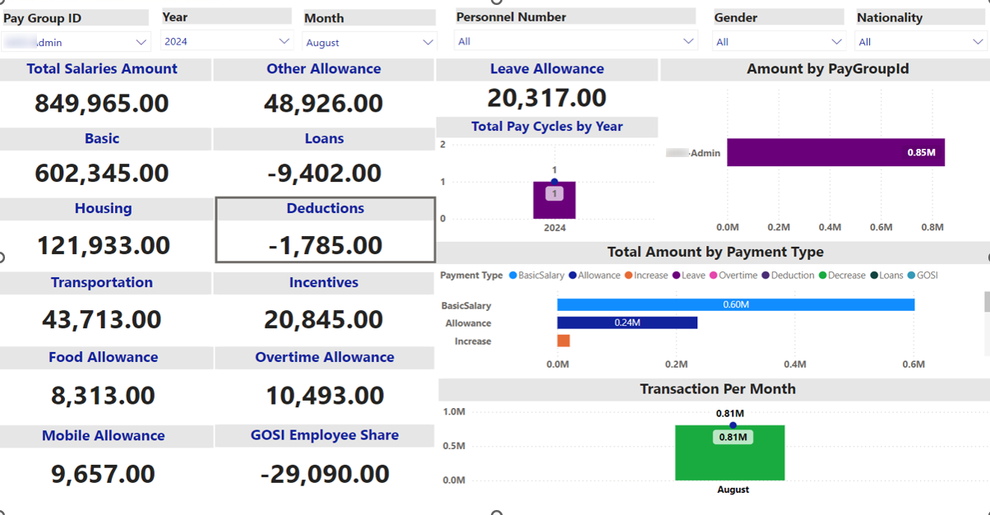
Salary Analysis

Slide 23
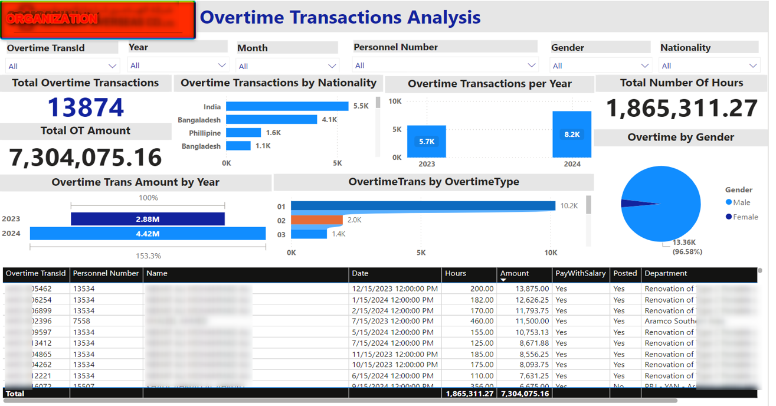

Slide 25
